Slide 1

AML-2304 Natural Language Processing
Lambton College
School of Computer Studies
[Prepared By: Vahid Hadavi, PhD]

Slide 2
Module 5 5. Illustrate Text Classification
Major Topics:
5.1 Import Libraries and the dataset
5.2 Perform Text Preprocessing
5.3 Perform feature extraction from Textual data
5.4 Prepare Training and Test Sets by splitting dataset
5.5 Demonstrate The training of the Text Classification Model (Naïve Bayes)
5.6 Analyze the results on test set and Evaluate the Model
5.7 Demonstrate saving and loading the Model

Slide 3
5.1 Import Libraries and the dataset

Slide 4
Supervised Classification
In supervised classification, we have access to labeled data for training a classifier.
Supervised classification is very common for handling text data.
Examples:
Evaluating social media
Extracting costumers’ concern about a product by performing sentiment analysis
Document classification
The NLTK library provides us with different types of classifiers such as Naive Bayes Classifier, Decision Tree Classifier, Support Vector Machine Classifier, etc.

Slide 5

Text classification
There are numerous reasons as to why we may need to perform text classification.
We may need to classify text as either education or politics or even military.
We may need classifying the text depending on the author who wrote it or based on gender.
A great application of text classification is when you need to classify text as either spam or not spam, such as how email filters work.
We will be using movie reviews dataset on NLTK, consisting 2000 movie reviews.

Slide 6
5.2 Perform Text Preprocessing

Slide 7



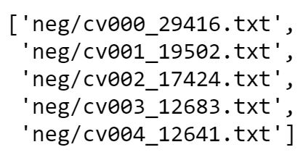
Text preprocessing

Slide 8
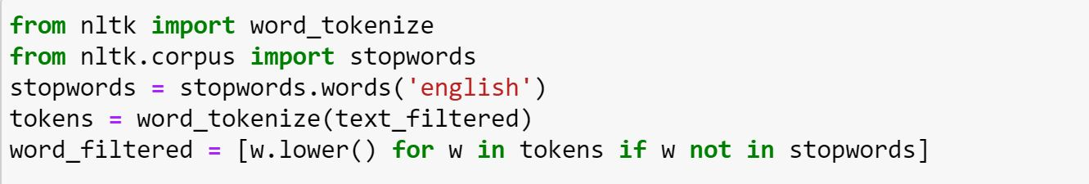
Text preprocessing
We remove the punctuations and stopwords and then make all words lowercase.

Slide 9

Text preprocessing
We can use FreqDist() function on NLTK to have a dictionary of frequency of apperacne of words in a text.

Slide 10
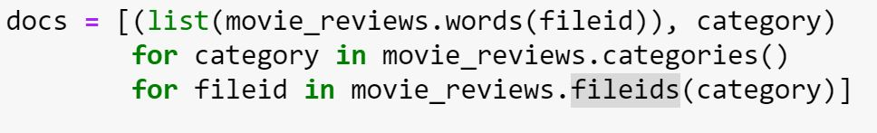
Text preprocessing
The above section of the code can be translated to:
In every category (we have either pos or neg), take the entire file IDs (every review has own ID),
Store the word_tokenized version (list of words) for the file ID, and then followed by the positive or negative label in one big list.

Slide 11
5.3 Perform feature extraction from Textual data

Slide 12
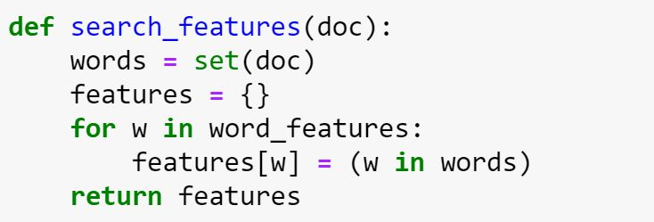
Feature extraction
We create a list containing 3000 most frequent words in the documents.
We consider existence/non-existence of these words in each of reviews as features by defining the following function.

Slide 13
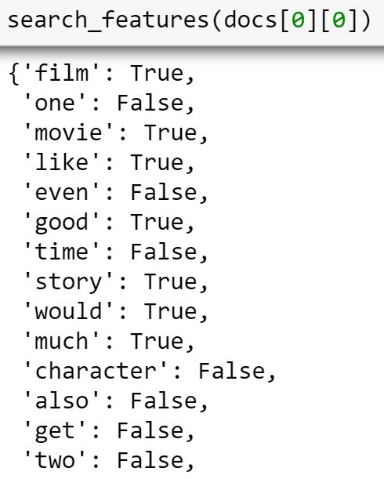
Feature extraction
We can test the function on the first review (docs was defined before as the list of tuples containing reviews with their corresponding sentiments).
These are only the first 14 words in the word_features variable (containing 3000 words) for the first review.

Slide 14
Feature extraction
Applying the function to all the reviews.

Slide 15
5.4 Prepare Training and Test Sets by splitting dataset

Slide 16

Training and testing set
Before we can train and test our algorithm, we should first split our data into training and test sets.
Since our dataset has been shuffled, the first 1600 shuffled reviews (consisting both positive and negative reviews) will be used as the training set.
The remaining 20% (400 reviews) will be used to perform the test.

Slide 17
5.5 Demonstrate The training of the Text Classification Model (Naïve Bayes)

Slide 18
Training
Since our data is labeled, this process is referred to as supervised learning.
We will use Naive Bayes on NLTK as the algorithm as it is a very popular algorithm for text classification.
We create the instance of the model and then train it on the training set.

Slide 19
4.6 Analyze the results on test set and Evaluate the Model

Slide 20

Model evaluation
We can evaluate the model accuracy by testing it on the testing set.
We can use classify.accuracy() function on nltk to determine the accuracy of a trained model.
It needs the trained model instance and the training test.

Slide 21
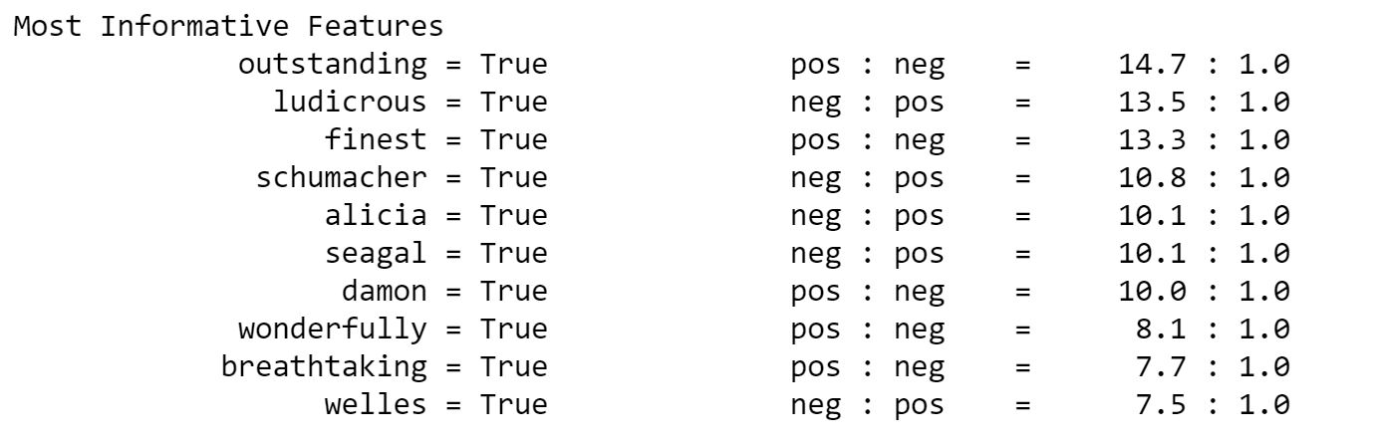
Most informative words
we can take it a step further to see what the most valuable words are when it comes to positive or negative reviews.
What this tells you is the ratio of occurrences in negative to positive, or visa versa, for every word.

Slide 22
5.7 Demonstrate saving and loading the Model

Slide 23
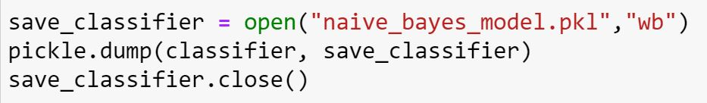
Saving
Training classifiers takes a long time.
Imagine we have to train the classifier every time that you want to use it, especially when a large dataset is involved.
We can use the pickle module to serialize a classifier object so that we only have to load it every time we need to use it.
We need to first import pickle.
It saves (pickles) the model with the name of ‘naive_bayes_model.pkl’ in the same folder.

Slide 24
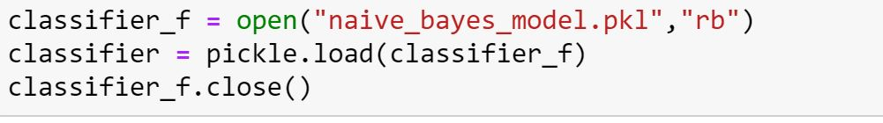
Loading
We can load the pickled model and use it for prediction.

Slide 25
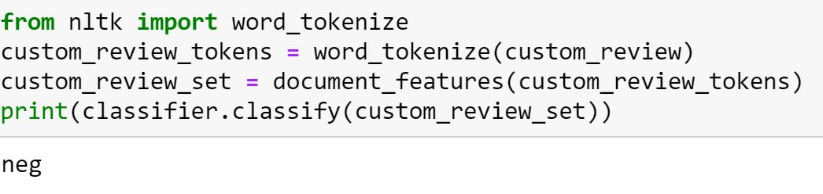
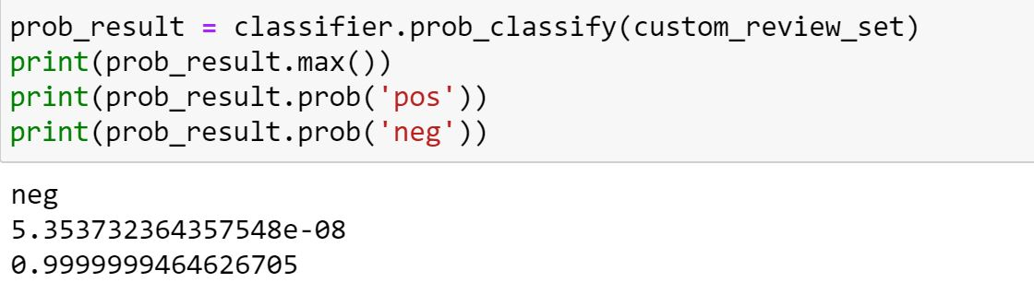
Testing a custom review
We can use our trained classifier to classify a new review.

Slide 26
Any questions so far? Any comments?

